Slide 1
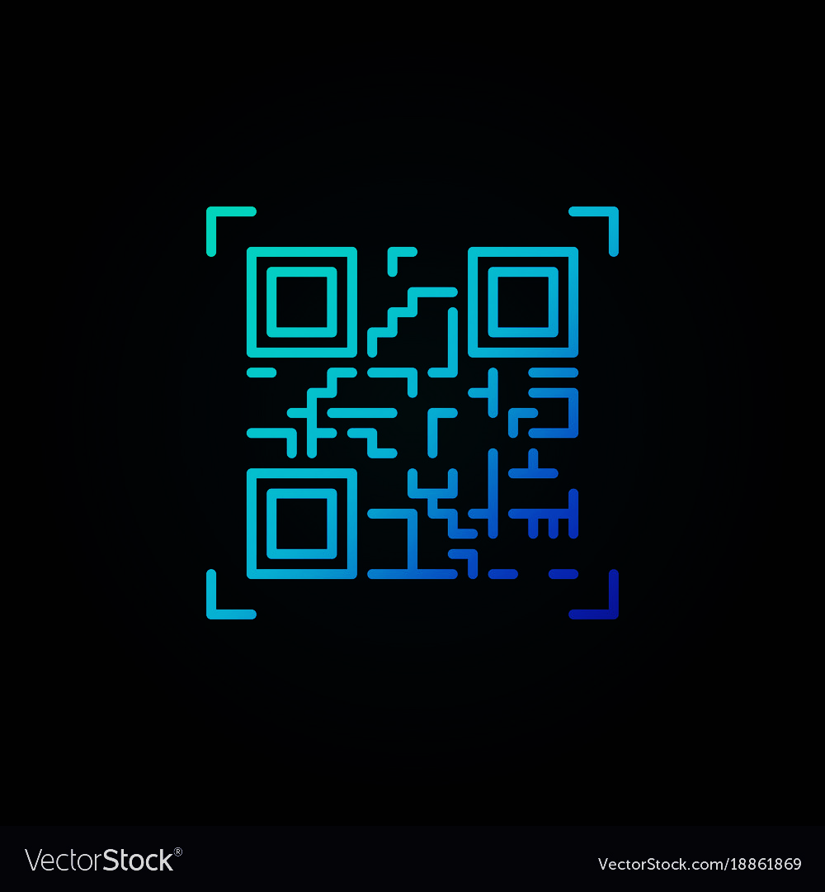
QR CODE GENERATOR
Presented by:
Joffin Francis
Adarsh Rohin V
Edwin John
Athira John
Donika Bose
Guide:Krishna Lal

Slide 2
INTRODUCTION
Data can be translated into a QR code by QR generator.
User’s simply enter data or URL address to be translated
The generator produces the translated code.

Slide 3
PROPOSED SYSTEM
THIS SYSTEM HELPS US TO GENERATE QR CODE BY ENTERING ANY VALUE

Slide 4
LANGUAGES USED
*HTML
*PYTHON
*CSS

Slide 5
SYSTEM SPECIFICATIONS
SYSTEM AND PLATFORM FREE

Slide 6
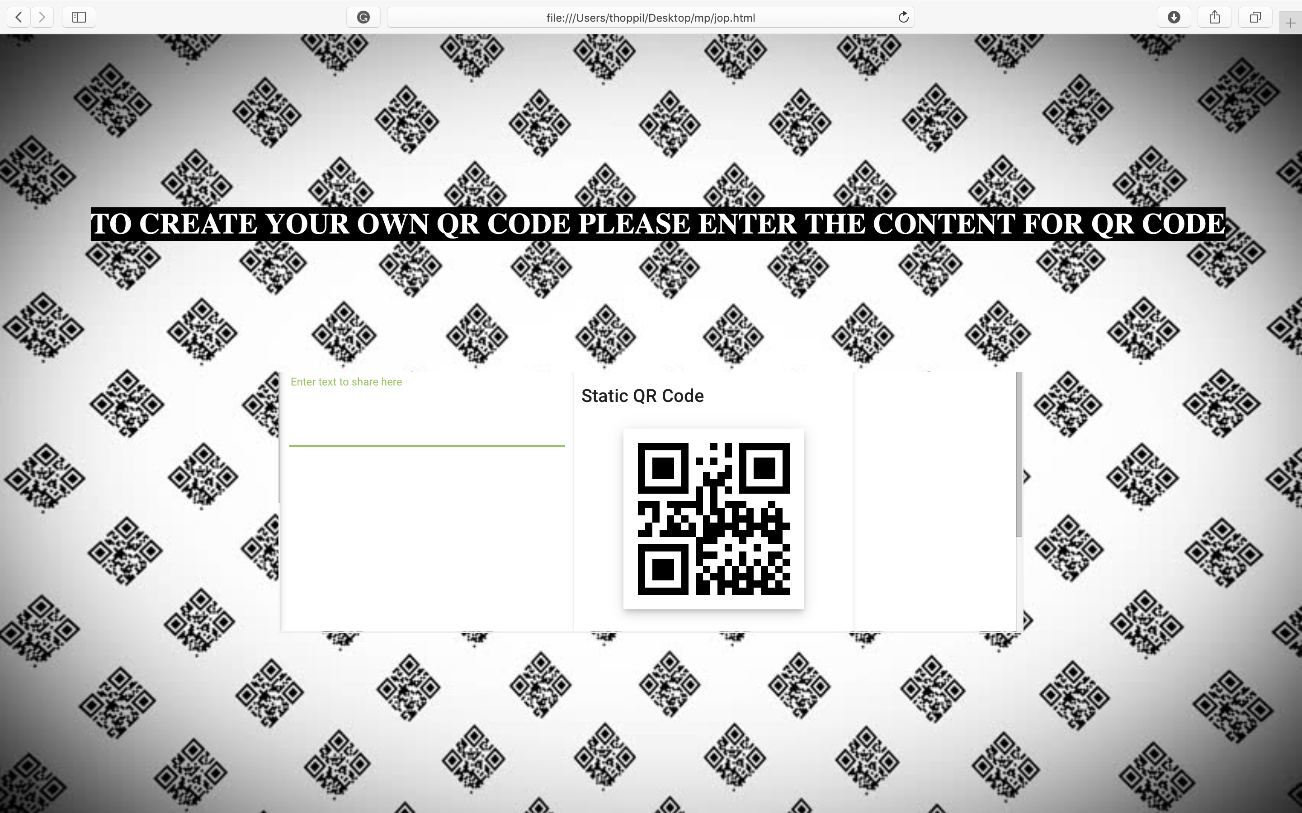

Slide 7
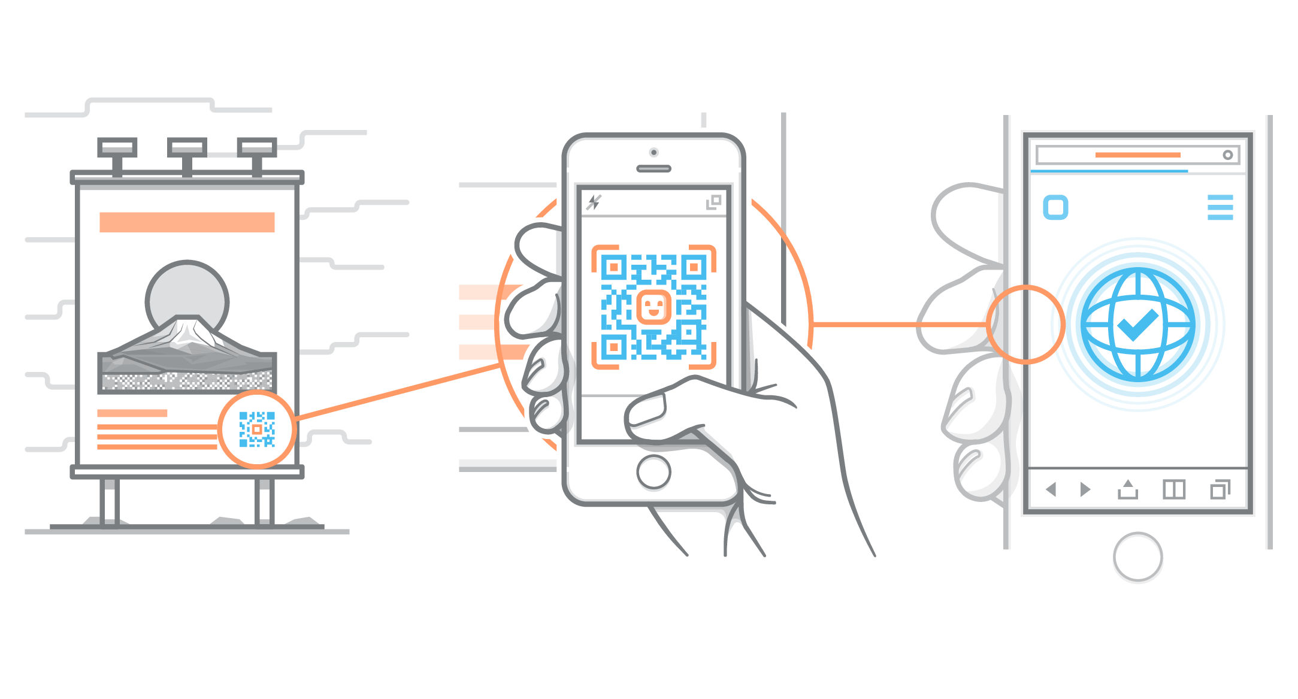

Slide 8
Conclusion
QR code is a way of encoding more information than a traditional bar code
QR code is now being widely used in a variety of businesses

Slide 9
THANK YOU

